Slide 1
A Multi-Agent Framework for Authentic Job Information Retrieval and Recommendation
TALENTLENS
A MUHAMMED KHAISE REHAN BIJU ABIKRISHNAN M S
Guided By,
Dr. Aswin V S
Digital University Kerala

Slide 2
The Invisible Epidemic: Online Employment Fraud
Why the modern job search is broken and dangerous.
TALENTLENS
53,000+
online job-fraud incidents in India (2021–2025, MHA data).
₹198 Cr
lost to employment scams in 2023 alone across the region. As per
Akhil Barathiya Suraksha Sangatham
89%
of job seekers report encountering fake offers or phantom listings.(INDEED SURVEY)

Slide 3
Real-Time 8-Stage Data Pipeline
Kafka-orchestrated microservices — from raw scrape to verified, searchable listing
TALENTLENS
AI-Job Intelligence Platform
ML-Powered Intelligence
Salary estimation, scam detection & skill extraction models
Dual Search Engine
Semantic search (Qdrant) plus full-text search (Elasticsearch)
Production Observability
Prometheus metrics, Grafana dashboards & MLflow tracking
One-Command Deployment
19 containers launched with a single docker compose command
1
2
3
4
Collector
Cleaner
Deduplicator
Enrichment
8
7
6
5
Gateway
Notifier
Embedder
Verifier
POWERED BY:FastAPI • MongoDB • Redis • Redpanda • Qdrant • Elasticsearch • Docker • Grafana
19
Containers Deployed
8
Microservices
3
ML Models
2
Search Engines

Slide 4

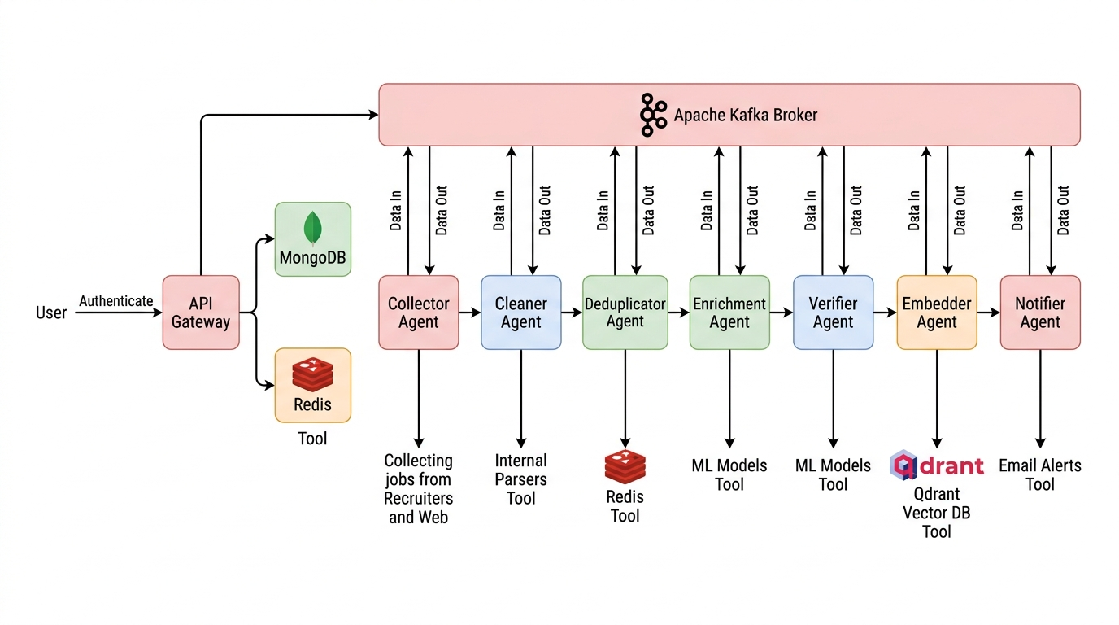
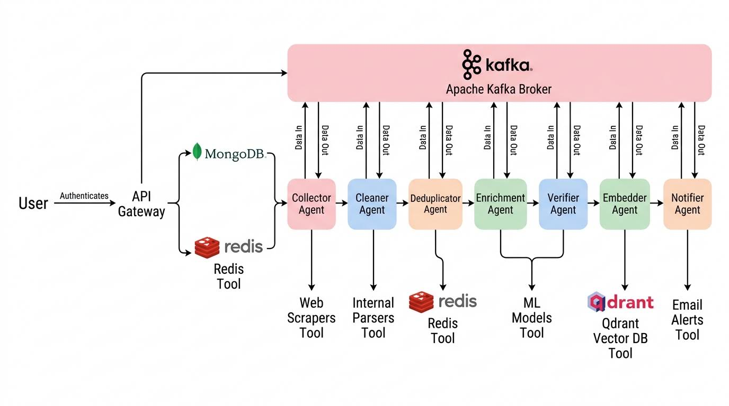
TALENTLENS

Slide 5
Thank you!
TalentLens
“Maximum Opportunity for job seekers .Zero tolerance for fraud”

